Slide 1



Infinity service
Presenter By:
Dharmendra Kumar Ram
Bibek Chaudhary

Slide 2
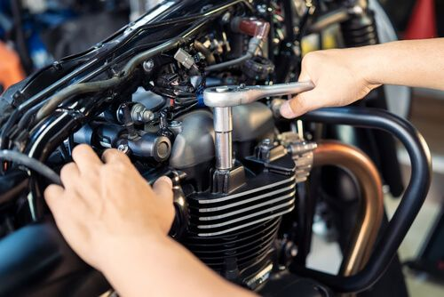
Agenda
Introduction
Statement of Problem
Objective
Features
Methodology
Feasibility study
System Architecture
Flow Chart
Use case Diagram
DFD Diagram
Waterfall model
Project Planning
Expected Outcomes & Conclusion

Slide 3
Introduction
Platform for small workshops for bikes
Service providing website
Easy bike servicing & maintenance appointments
Easy maintenance incase of break down
Bike spare parts as secondary trade dealership

Slide 4
Statement of Problem
No digitalization in workshops
Wait in long queue
No records of previous servicing
No access to mechanic
INFINITY SERVICE
4

Slide 5
Objectives
Time Management
Digital record keeping of servicing and maintenance
Digital record keeping of inventories of spare parts
Easy access to mechanic
INFINITY SERVICE
5

Slide 6
Features
Register and login by users
Login to the admin
Users submitting forms for using different type of services
Buy products
INFINITY SERVICE
6

Slide 7
Methodology
Requirements Identification
Requirement of existing system
Third Wheel
Requirement Collection
Questionnaire
Observation
INFINITY SERVICE
7

Slide 8
Feasibility Study
Technical Feasibility
Operational Feasibility
Economic Feasibility
INFINITY SERVICE
8

Slide 9
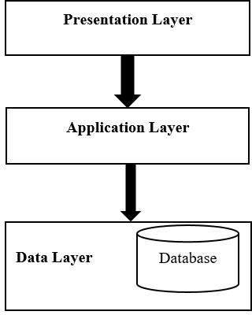
System Architecture
Fig: Three-tier Architecture
INFINITY SERVICE
9

Slide 10
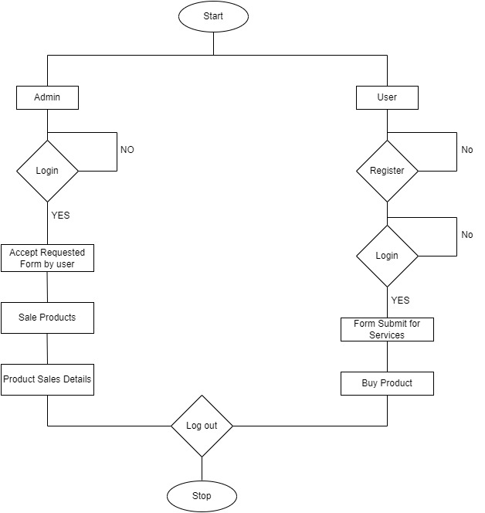
Flow Chart
Fig: System Flow Chart
INFINITY SERVICE
10

Slide 11
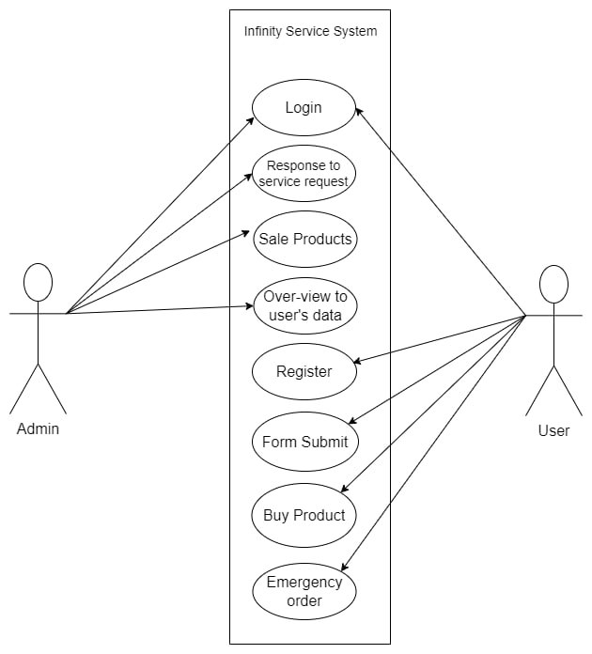
Use Case
Fig: Use Case Diagram
INFINITY SERVICE
11

Slide 12
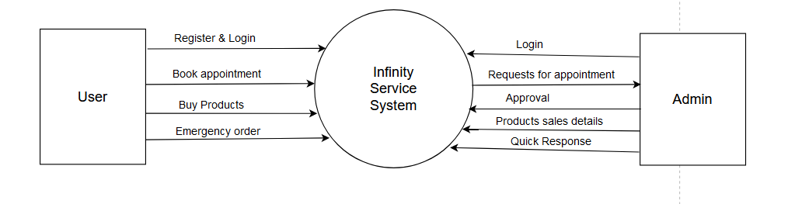
Data Flow Diagram (DFD)
Fig: DFD 0 Level of Infinity Service
INFINITY SERVICE
12

Slide 13
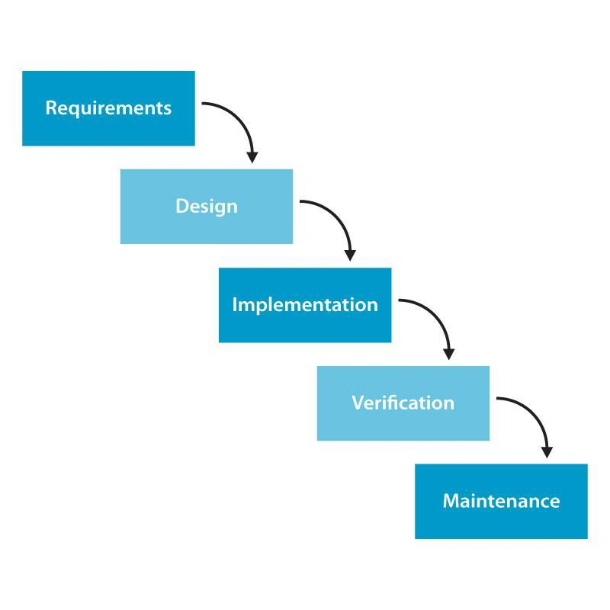
Methodology of Proposed System
Fig:- Waterfall Model
INFINITY SERVICE
13

Slide 14
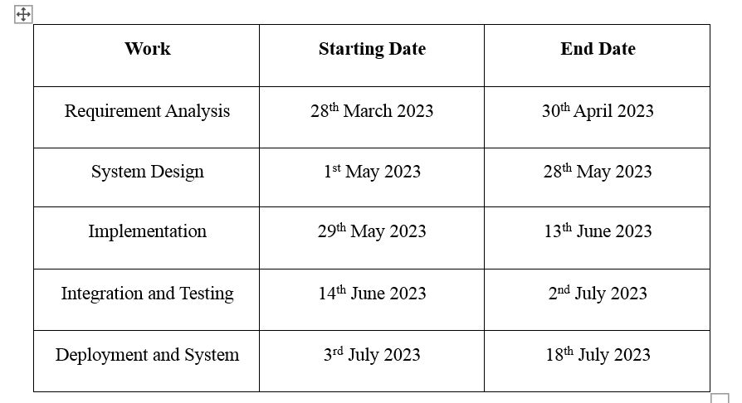
Project Planning
Fig: Scheduling
INFINITY SERVICE
14

Slide 15
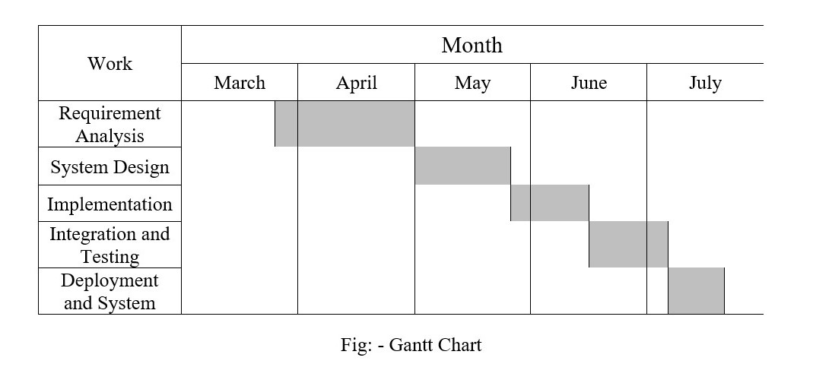
Project Planning
INFINITY SERVICE
15

Slide 16
Outcomes & Conclusion
Saves own identity of workshops.
Reliable platform for booking bike appointment for servicing and maintenance.
Saves time.

Slide 17
Thank you

